Slide 1
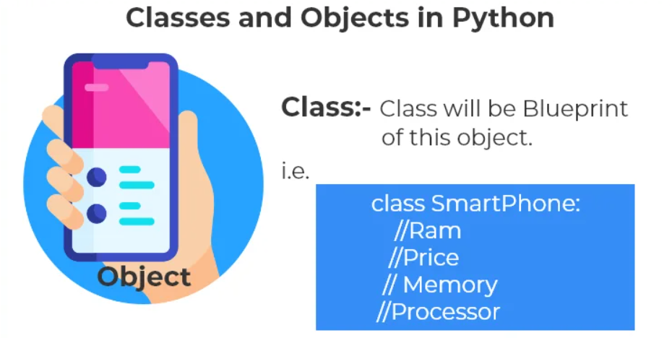
Classes and Objects In Python
The class can be defined as a collection of objects. It is a logical entity that has some specific attributes and methods.
Object is a simple entity which posses some property or behavior.

